Slide 1
Applies Data Structure and Application
Dr Sachin K Saxena Sr Data Analyst, Portugal, MNC
Ex-Sr Software Engineer - Data Scientist

Slide 3
Content
Types of Tress:
Threaded Binary trees
AVL Trees
Introduction to Multi-way Search trees
B-tree

Slide 4
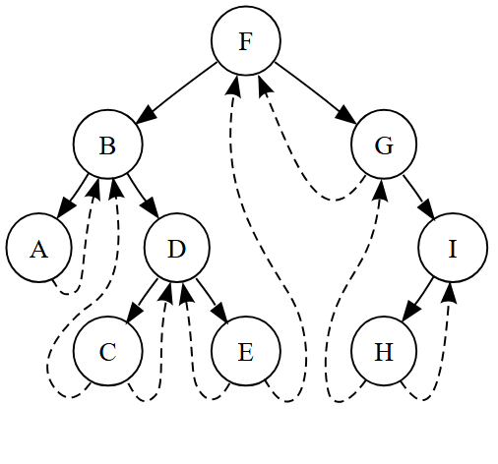
Threaded Binary trees
A threaded binary tree is the same as that of a binary tree but with a difference in storing the NULL pointers.
For example, the NULL entries can be replaced to store a pointer to the in-order predecessor or the in order successor of the node.
These special pointers are called threads and binary trees containing threads are called threaded trees.
A Threaded Binary Tree lets us perform inorder traversal without the use of recursion or stack

Slide 5
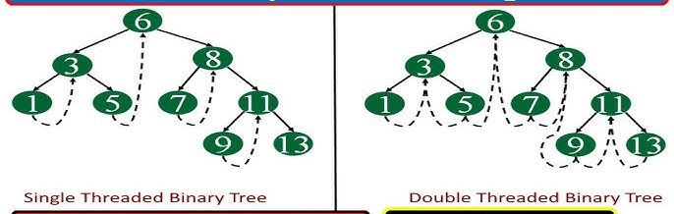
Threaded Binary trees
Single Threaded
Diagramatic Representation of Single Threaded Binary Tree As we can see from the diagram, only the right pointer which is NULL point to the successor node in a single-threaded binary tree
Double Threaded
Diagramatic Representation of Double Threaded Binary Tree In a double threaded Binary tree, the left pointer also points to its predecessor node

Slide 6
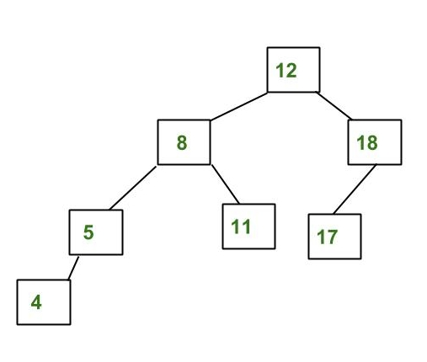
AVL Trees
An AVL tree is a self-balancing Binary Search Tree (BST).
Due to being a Binary Search Tree, an AVL tree can have at most two child nodes for any node,
and all nodes in the left subtree of a node are smaller than the node, while all nodes in the right subtree are greater than the node.

Slide 7
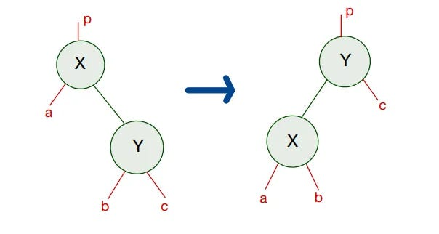
AVL Trees
In an AVL tree, each node maintains a data called Balance Factor, which represents the difference in heights between the left and right subtrees.
The tree is considered balanced when the Balance Factor is -1, 0, or 1, and no rebalancing is required.
However, if the Balance Factor deviates from these three values, the tree needs to be rebalanced.
There are four ways to perform these rebalancing operations:
1. Left Rotation
2. Right Rotation
3. Left-Right Rotation
4. Right-Left Rotation

Slide 8
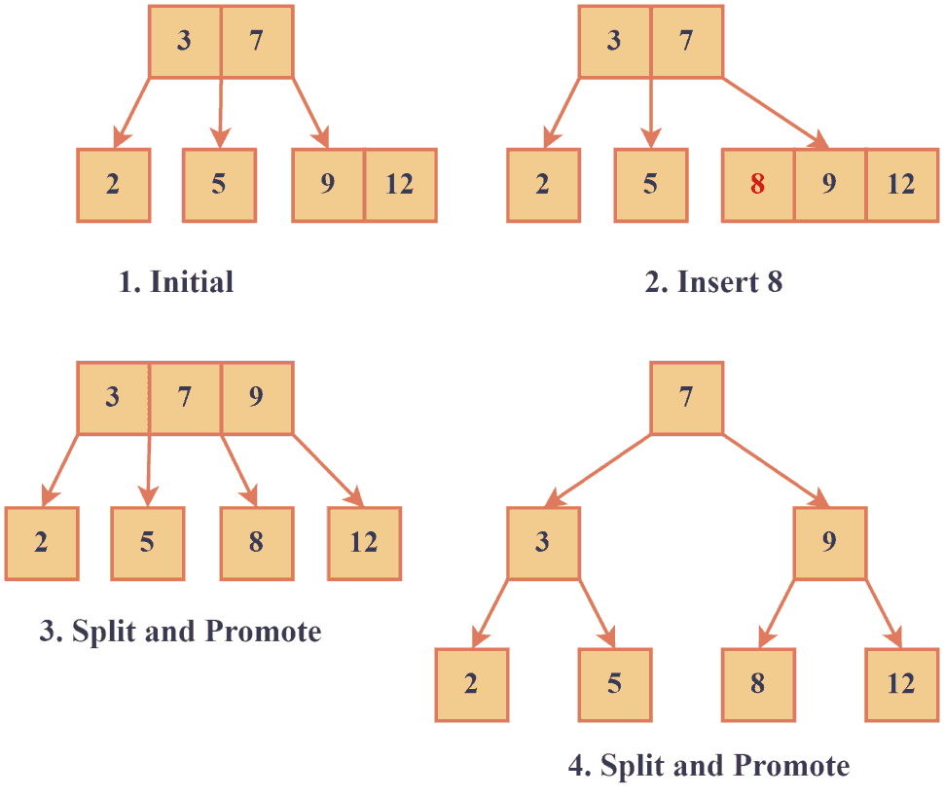
Introduction to Multi-way Search trees
Multi-way search trees are a generalized version of binary trees that allow for efficient data searching and sorting. In contrast to binary search trees, which can only have two children per node, multi-way search trees can have multiple children per node.
Types of Multi-way Search Trees
There are several types of multi-way search trees, each with unique features and use cases. The two common types are 2-3 and B-tree.

Slide 9
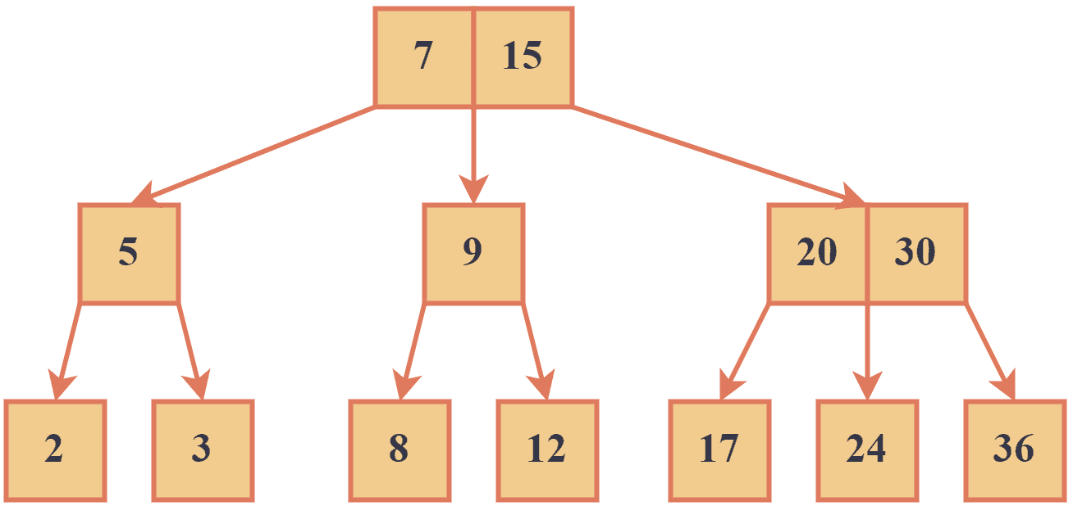
Introduction to Multi-way Search trees
2-3 Tree
2-3 trees are multi-way search trees with two or three children per node.
The nodes in a 2-3 tree are sorted so that the smallest key is always in the leftmost child and the largest key is always in the rightmost child.
They’re often used in applications that require moderate amounts of data, such as compilers and interpreters.

Slide 10
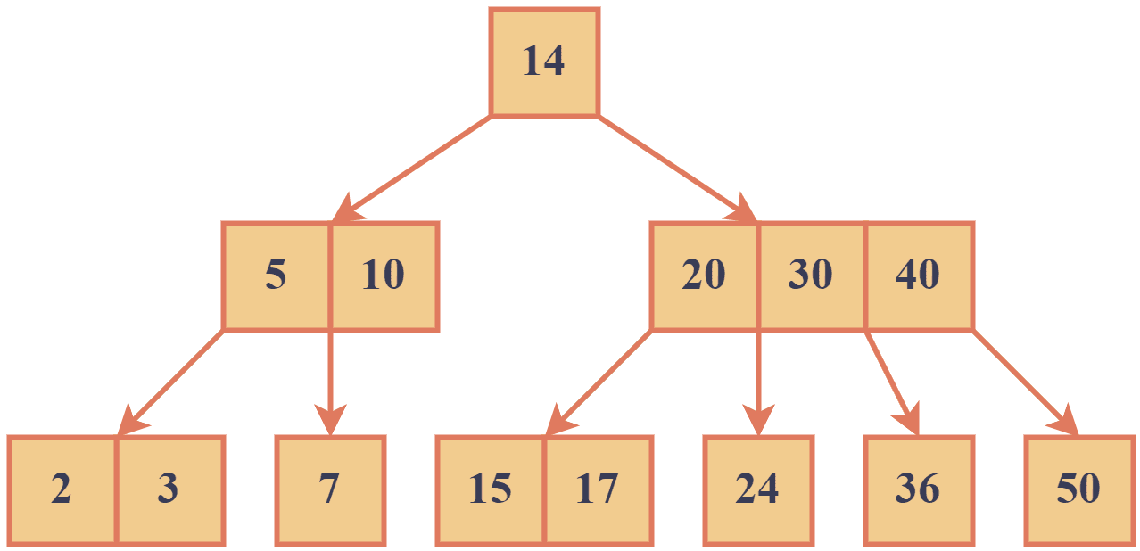
Introduction to Multi-way Search trees
B-Trees
B-trees have a variable number of children per node, typically ranging from 2 to hundreds.
Like 2-3 trees, B-trees are sorted so that keys are ordered from left to right. 2-3 trees are designed to optimize disk reads by ensuring that each node takes up a fixed amount of space on the disk.

Slide 11
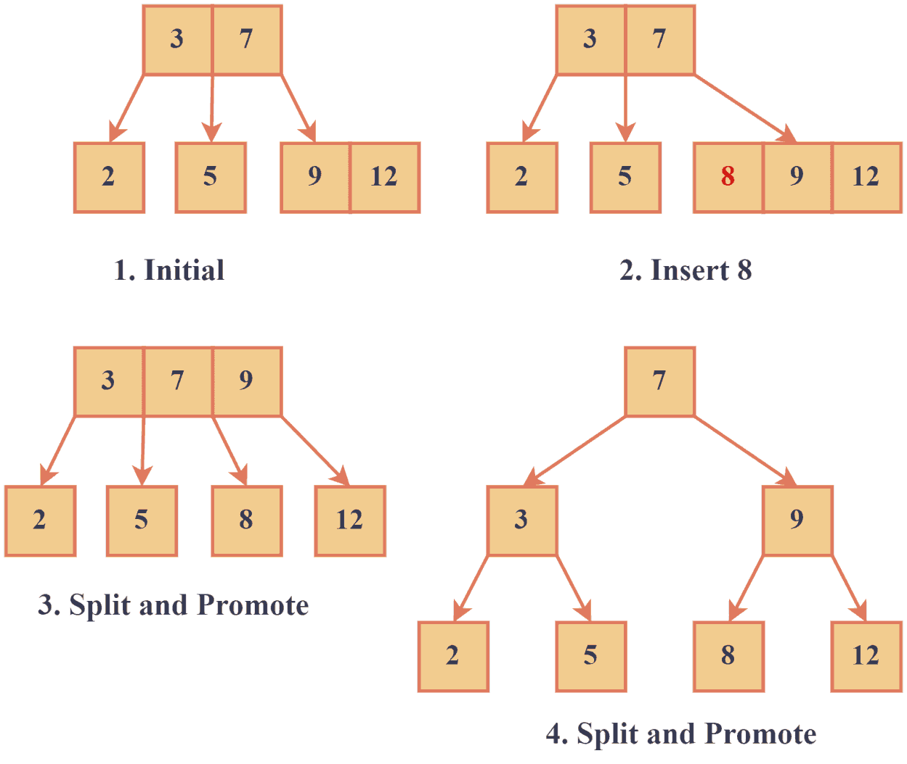
Introduction to Multi-way Search trees

Slide 12
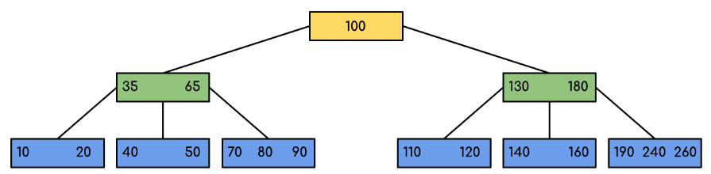
B-tree
A B-tree is essentially a balanced tree where each node can contain multiple keys, leading to fewer levels or “depth” in the tree, which translates to faster data access.

Slide 13
Thanking you !!!!
Any question !!!!!
Download PPT : https://github.com/sachin365123/Applies-Data-Structure-and-Application-GLA-Online-Sessions-Jan---Jun-2026

